Slide 1
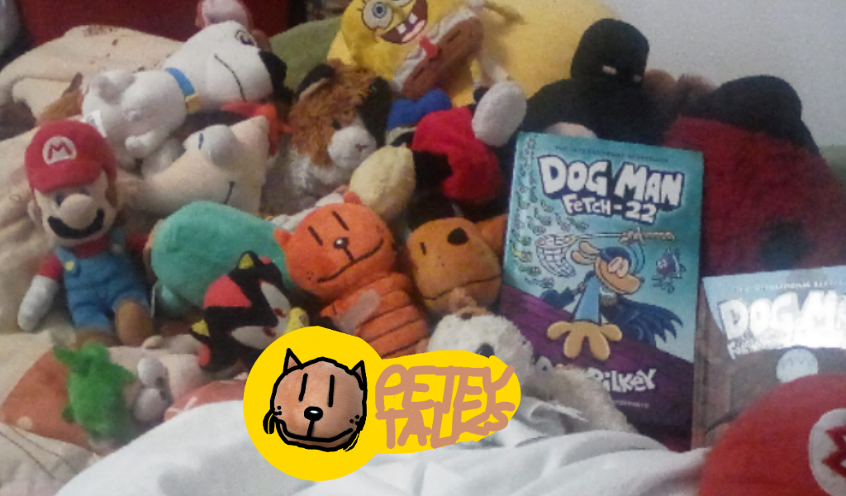

user
Username
Password

Slide 2

user
Welcome

Slide 3

Wait for it…

Slide 4




The Sonic Pro Menu (SonicDroid PC) 2.0
www.sonicpromenu.org/index.html
Pre-acquired by
©Sonic Pro Tube, TriggerFox, Spain-Mart, 2019, 2020, 2026, 2027. All rights reserved.

Slide 5


Slide 7

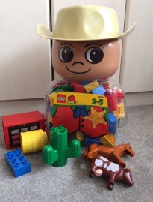






Super Settings
Squeak
Story
CTYPO!
Dance Test
Sonic Pro Tube
More coming soon*
Jukeboxinator

Slide 8

Super Settings
Squeak
Story
CTYPO!
Dance Test
Sonic Pro Tube
More coming soon*
Jukeboxinator
Do not click this again
Until Soon.

Slide 9


Slide 10
Press F to Pay Respects

